Slide 1
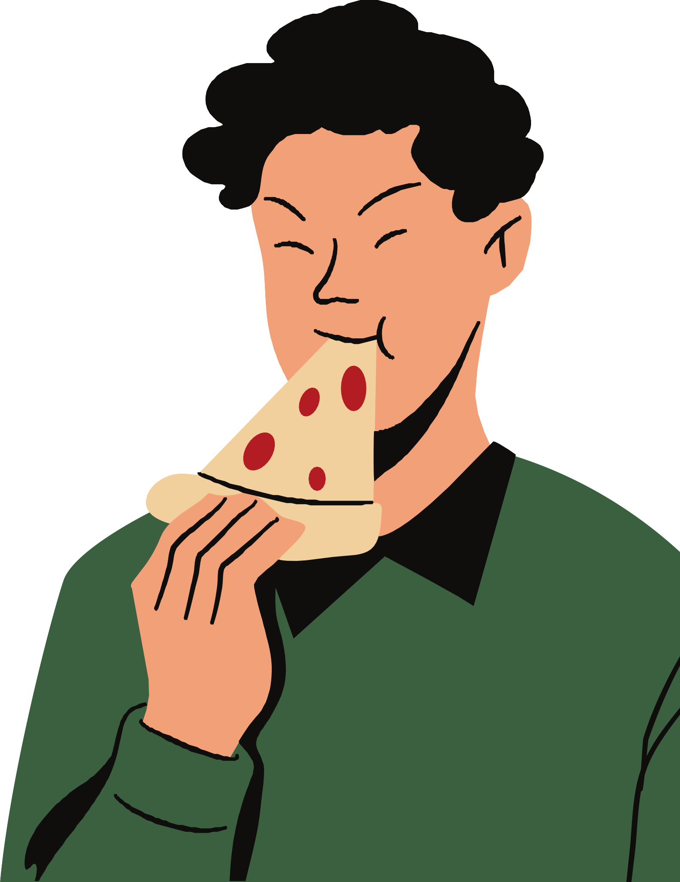



Pizza Sales Analysis Using SQL Prepared By : Purvang Majevadiya

Slide 2

Plot: Mr. Neil Milano Owns a pizza shop. He has maintained sales data on a csv named Pizza, Pizza Types, Orders, Order Details. He want insights from these data to improve his business for this pizza shop. He gave me queries to find their answer. Let’s dive into this interesting task.

Slide 3
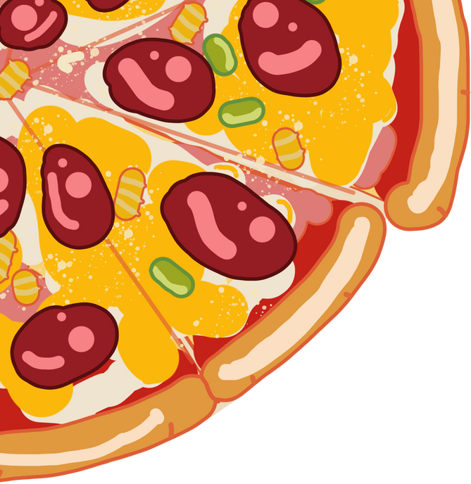

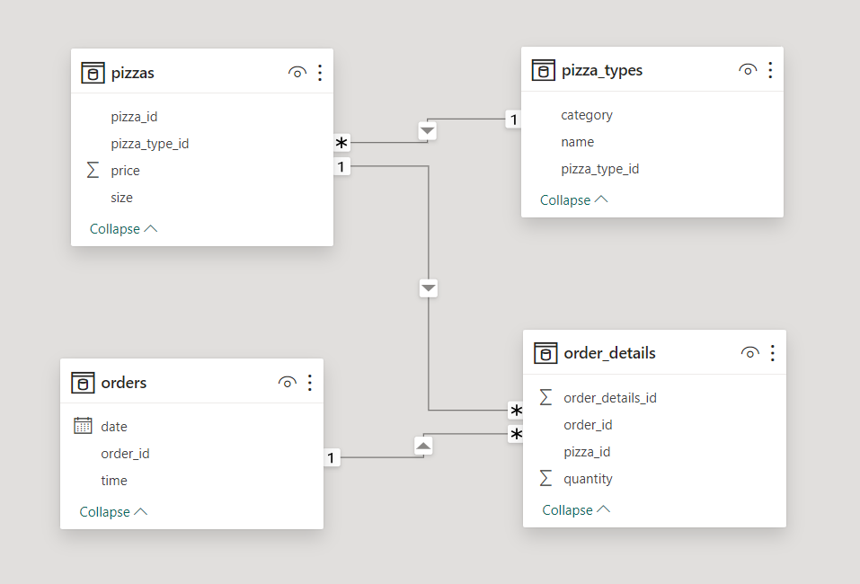
DATABASE SCHEMA

Slide 4
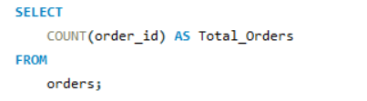
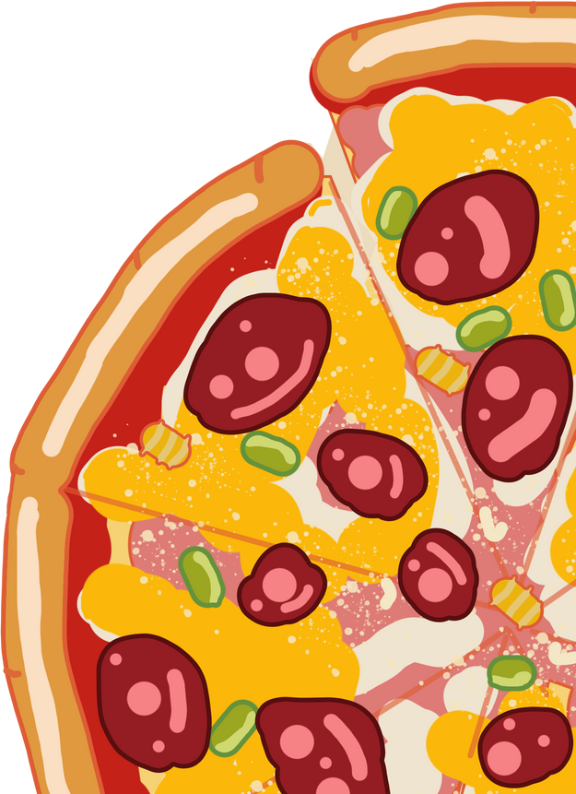

Retrieve the total number of orders placed.

Slide 5
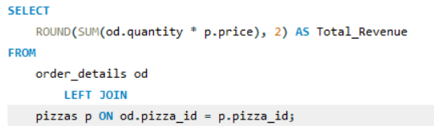

Calculate the total revenue generated from pizza sales.

Slide 6
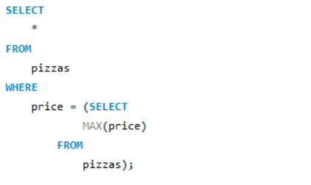

Identify the highest-priced pizza.

Slide 7
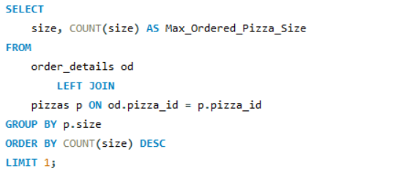

Identify the most common pizza size ordered.

Slide 8
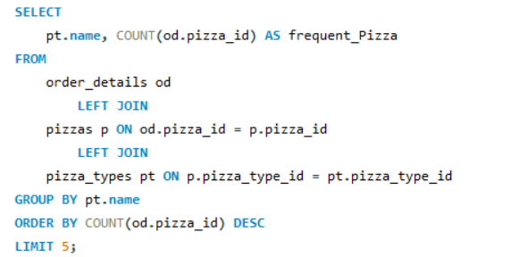
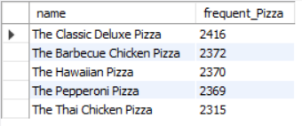
List the top 5 most ordered pizza types along with their quantities.

Slide 9
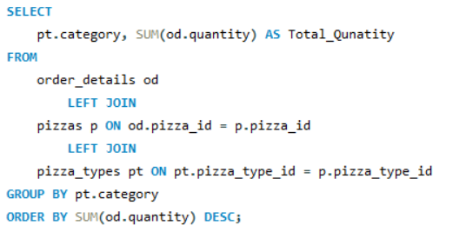
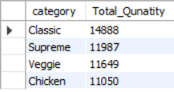
Join the necessary tables to find the total quantity of each pizza category ordered.

Slide 10
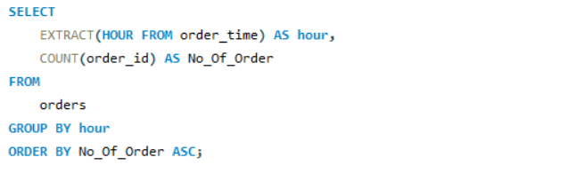
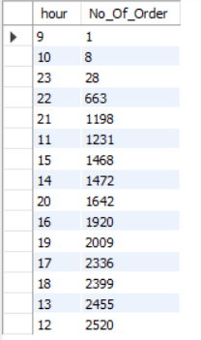
Determine the distribution of orders by hour of the day.

Slide 11
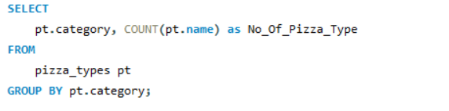
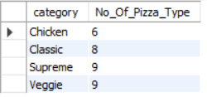
Join relevant tables to find the category-wise distribution of pizzas.

Slide 12
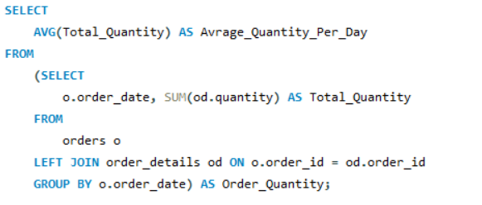

Group the orders by date and calculate the average number of pizzas ordered per day.

Slide 13
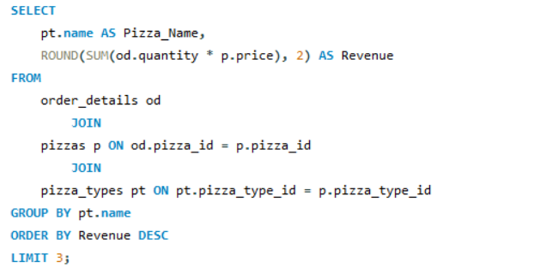

Determine the top 3 most ordered pizza types based on revenue.

Slide 14
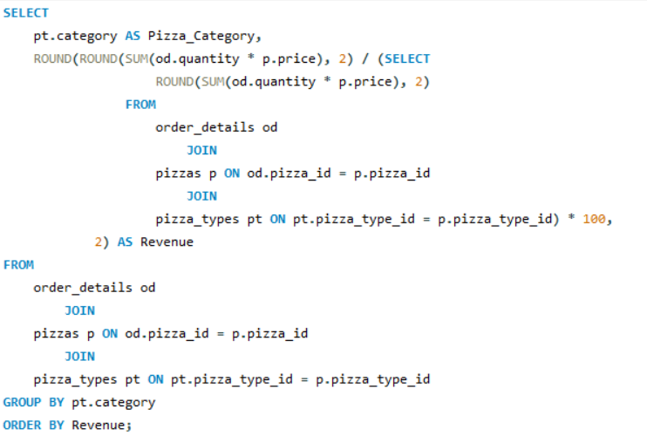
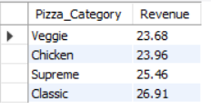
Calculate the percentage contribution of each pizza type to total revenue.

Slide 15
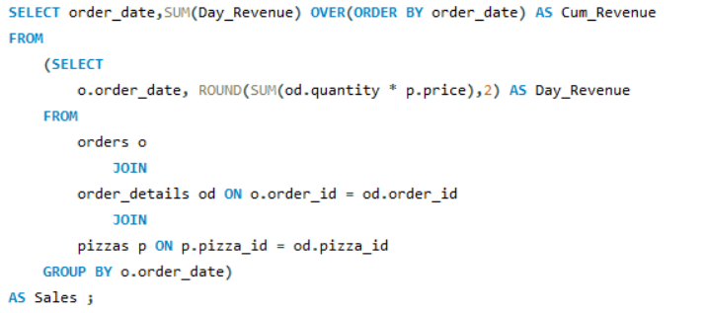
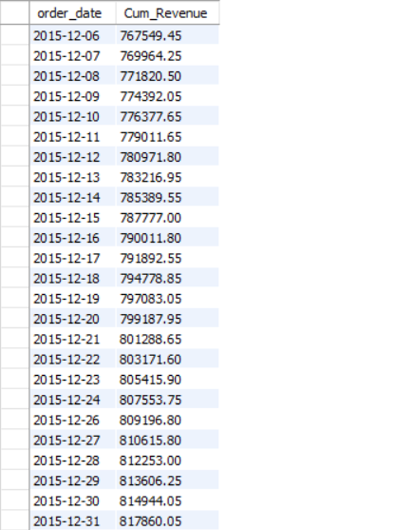
Analyze the cumulative revenue generated over time.

Slide 16
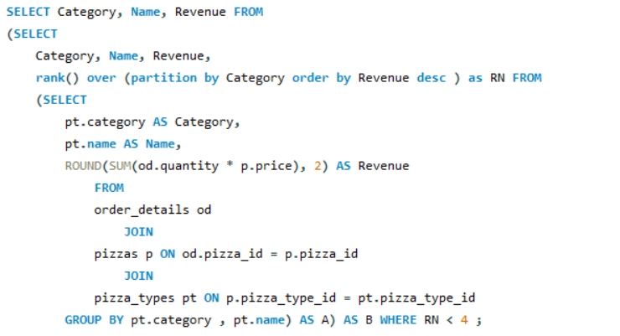
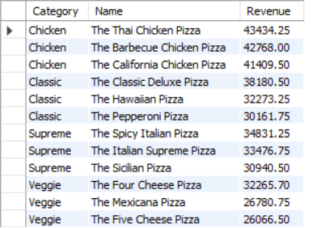
Determine the top 3 most ordered pizza types based on revenue for each pizza category.

Slide 17

Mr. Neil Milano’s pizza shop has processed 21,350 orders with total revenue of $817,860.05. The most common pizza size is Large (L), ordered 18,526 times, and the highest-priced pizza is The Greek XXL at $35.95. Top 5 frequent pizzas include The Classic Deluxe and The Barbecue Chicken Pizza. Classic pizzas contribute the most sales, followed by Supreme, Chicken, and Veggie categories. Revenue-wise, The Thai Chicken Pizza leads, generating $43,434.25, while Classic pizzas contribute 26.91% of total revenue. Daily orders average 138.47, with peak orders on certain days indicating high customer engagement. The business shows strong demand for variety across categories and consistent sales patterns.
Summary

Slide 18
Thank You

